Slide 1
Our customers define the shape of the world.
we make it
possible.
^{phone conference call}
^{Pesaro 4 p.m. November 11}

Slide 2
Biesse highlights Sept. 2016
^{orders intake:} + 13.4%
^{backlog:} +16.5%
^{net} ^{sales:} € 436.4 +19.5%
^{net debt:} € 16.7 -35.2%
^{EBITDA:} € 50.8 (incidence 11.6%)
^{EBIT:} € 36.9 (incidence 8.5%)

Slide 3
R.O.E. tree (simplified)
R.O.E.
sept.15 12.3% – sept.16 16.2%
financial leverage
sept.15 3.5% – sept.16 3.6%
R.O.S.
sept.15 8.3%– sept.16 8.3%
capital rotation index
sept.15 0.84 – sept.16 0.94
R.O.I.
sept.15 7.0% – sept.16 7.8%
Net profit/Equity
Asset/Equity
Operative profit/Asset
Operative profit/Sales
Sales/Asset
29

Slide 4
Extract of the P&L – 9M 2016
€/mln | FY 2013 | FY 2014 | FY 2015 | 9m 2015 | 9m 2016 | IH 2016
Net sales year -1 | 378.4 -1.2% | 427.1 +12.9% | 519.1 +21.5% | 365,1 | 436.4 +19,5% | 283.4 +15.4%
Value added % | 143.5 37.9% | 169.1 39.6% | 212.4 40.9% | 150,7 41,3% | 177,9 40,8% | 116.4 41.1%
Labour cost % | 112.7 29.8% | 128.2 30.0% | 148.2 28.6% | 107,5 29,5% | 127,1 29,1% | 85.9 30.3%
EBITDA % | 30.9 8.2% | 40.9 9.6% | 64.1 12.4% | 43,2 11,8% | 50,8 11,6% | 30.4 10.7%
EBIT* % | 18.1 4.8% | 26.5 6.2% | 43.8 8.4% | 29,7 8,1% | 36,9 8,5% | 20.9 7.4%
Net Result % | 4.3 1.1% | 13.8 3.2% | 21.1 4.1% | 14,9 4,1% | 20,9 4,8% | 11.9 4.2%
*before non recurring items
tax rate 43,8% 41.5%

Slide 5
Net Sales trend – 9 months
€/mln
FY 2009
FY 2010
FY 2011
FY 2012
FY 2013
FY 2014
FY 2015
9M 2009
9M 2010
9M2011
9M 2012
9M 2013
9M 2014
9M 2015
9M 2016

Slide 6
Sales breakdown- September 2016
by business division
by main geo-area
Italy 12.4%
Italy 12.7%
Italy 13.3%

Slide 7

orders intake & backlog
9M 2016: Group orders intake +13.4% (vs. the same period 2015)
9M 2016: Group backlog +16.5% (vs. the same period 2015) -backlog September 2016 € 170 mln-
€/mln
FY 2009
FY 2010
FY 2011
FY 2012
FY 2013
FY 2014
FY 2015
9M2015
9M 2016

Slide 8
Labour cost trend - 9M
€/mln
9M 2009
9M 2010
9M 2011
9M 2012
9M 2013
9M 2014
9M 2015
9M 2016
FY 2009
FY 2010
FY 2011
FY 2012
FY 2013
FY 2014
FY 2015

Slide 9
EBITDA trend - 9M
€/mln
9M 2009
9M 2010
9M 2011
9M 2012
9M 2013
9M 2014
9M 2015
9M 2016
FY 2009
FY 2010
FY 2011
FY 2012
FY 2013
FY 2014
FY 2015

Slide 10
Net Debt trend - 9M
€/mln
9M 2009
9M 2010
9M 2011
9M 2012
9M 2013
9M 2014
9M 2015
9M 2016
FY 2009
FY 2010
FY 2011
FY 2012
FY 2013
FY 2014
FY 2015

Slide 11
Cashflow 9M 2016
-
€/mln | FY 2013 | FY 2014 | FY 2015 | 9M 2015 | 9M 2016 | IH 2016
Gross Cashflow % net sales | 52.1 13.8% | 38.3 9.0% | 46.3 8.9% | +8.4 | +15.9
Investments % net sales | -19.9 5.2% | -20.8 4.9% | -25.2 4.9% | -16.8 | -20.7
Net Cashflow % | 32.3 8.5% | 17.5 4.1% | 21.1 4.0% | -8.4 | -4.8
not ordinary items (dividends/treasury shares activity balance /acquisitions payment) | -- | -4.8 div. paid € 0.18 per share | -9.8 div. paid € 0.36 per share | -6.2 div. paid € 0.36 per share | -12.0 div. paid € 0.36 per share
delta Net debt | +32.3 | +12.7 | +11.3 | -14.6 | -16.8 | -0.6
NET FINANCIAL POSITION | -23.9 | -11.2 | 0.1 | -25.8 | -16.7 | -0.5

Slide 12
Operating Net Working Capital 9M 2016
€/mln | FY 2013 | FY 2014 | FY 2015 | 9M 2015* | 9M 2016* | FY 2016e
Inventories % net sales | 22.8% | 23.0% | 21.5% | 23.8% | 22.5% |  | DSI 169 days
Receivables % net sales | 20.1% | 18.9% | 20.3% | 18.7% | 20.8% |  | DSO 55 days
Payables % net sales | 29.4% | 28.8% | 29.5% | 28.0% | 31.2% |  | DPO 113 days
Operating Net Working Capital % net sales | 51.4 13.6% | 55.6 13.0% | 63.4 12.2% | 66.8 14.5% | 72.0 12.1% | 72.0 12.6%
*calculated considering the full year revenues (2016 expected revenues)

Slide 13
People distribution (without interim people)
*including Uniteam people (nr. 57)
 | FY 2010 | FY 2011 | FY 2012 | FY 2013 | FY 2014 | FY 2015 | Sept 2015 | Sept 2016
Production % of total people | 965 41% | 1250 46% | 1265 45% | 1175 44% | 1201 42% | 1335 42% | 1276 41% | 1426 41%
Service & After sale % of total people | 568 24% | 577 21% | 574 21% | 613 22% | 628 22% | 690 22% | 651 22% | 788 22.4%
R&D % of total people | 293 12% | 316 12% | 338 12% | 321 12% | 361 13% | 383 13% | 369 12% | 428 12.2%
Sales & Marketing % of total people | 340 13% | 361 13% | 364 13% | 351 13% | 439 15% | 495 15.6% | 470 15.5% | 565 16%
G & A % of total people | 202 9% | 233 9% | 242 9% | 235 9% | 252 9% | 273 9% | 251 8.3% | 302 8.6%
ITALY % of total people | 1660 70% | 1656 61% | 1646 59% | 1547 57% | 1605 56% | 1780 56% | 1689 56% | 1927 55%
OUTSIDE ITALY** % of total people | 708 30% | 1081 39% | 1136 41% | 1148 43% | 1276 44% | 1396 44% | 1338 44% | 1582 45%
TOTAL | 2368 | 2737 | 2782 | 2695 | 2881 | 3176 | 3,027 | 3,509*

Slide 14
People distribution
*including Uniteam people (nr. 57)
 | FY 2010 | FY 2011 | FY 2012 | FY 2013 | FY 2014 | FY 2015 | Sept 2015 | Sept 2016
ITALY % of total people | 1660 70% | 1656 61% | 1646 59% | 1547 57% | 1605 56% | 1780 56% | 1689 56% | 1927 55%
OUTSIDE ITALY** % of total people | 708 30% | 1081 39% | 1136 41% | 1148 43% | 1276 44% | 1396 44% | 1338 44% | 1582 45%
TOTAL | 2368 | 2737 | 2782 | 2695 | 2881 | 3176 | 3,027 | 3,509*
vs Sep 2015: +482 (15.9%)
vs Dec 2015: +333 (10.5%)
vs Jun 2016: +50 (1.45%)
interim people at the end of Sept. 2015: 147
interim people at the end of Sept. 2016: 232
3,741

Slide 15
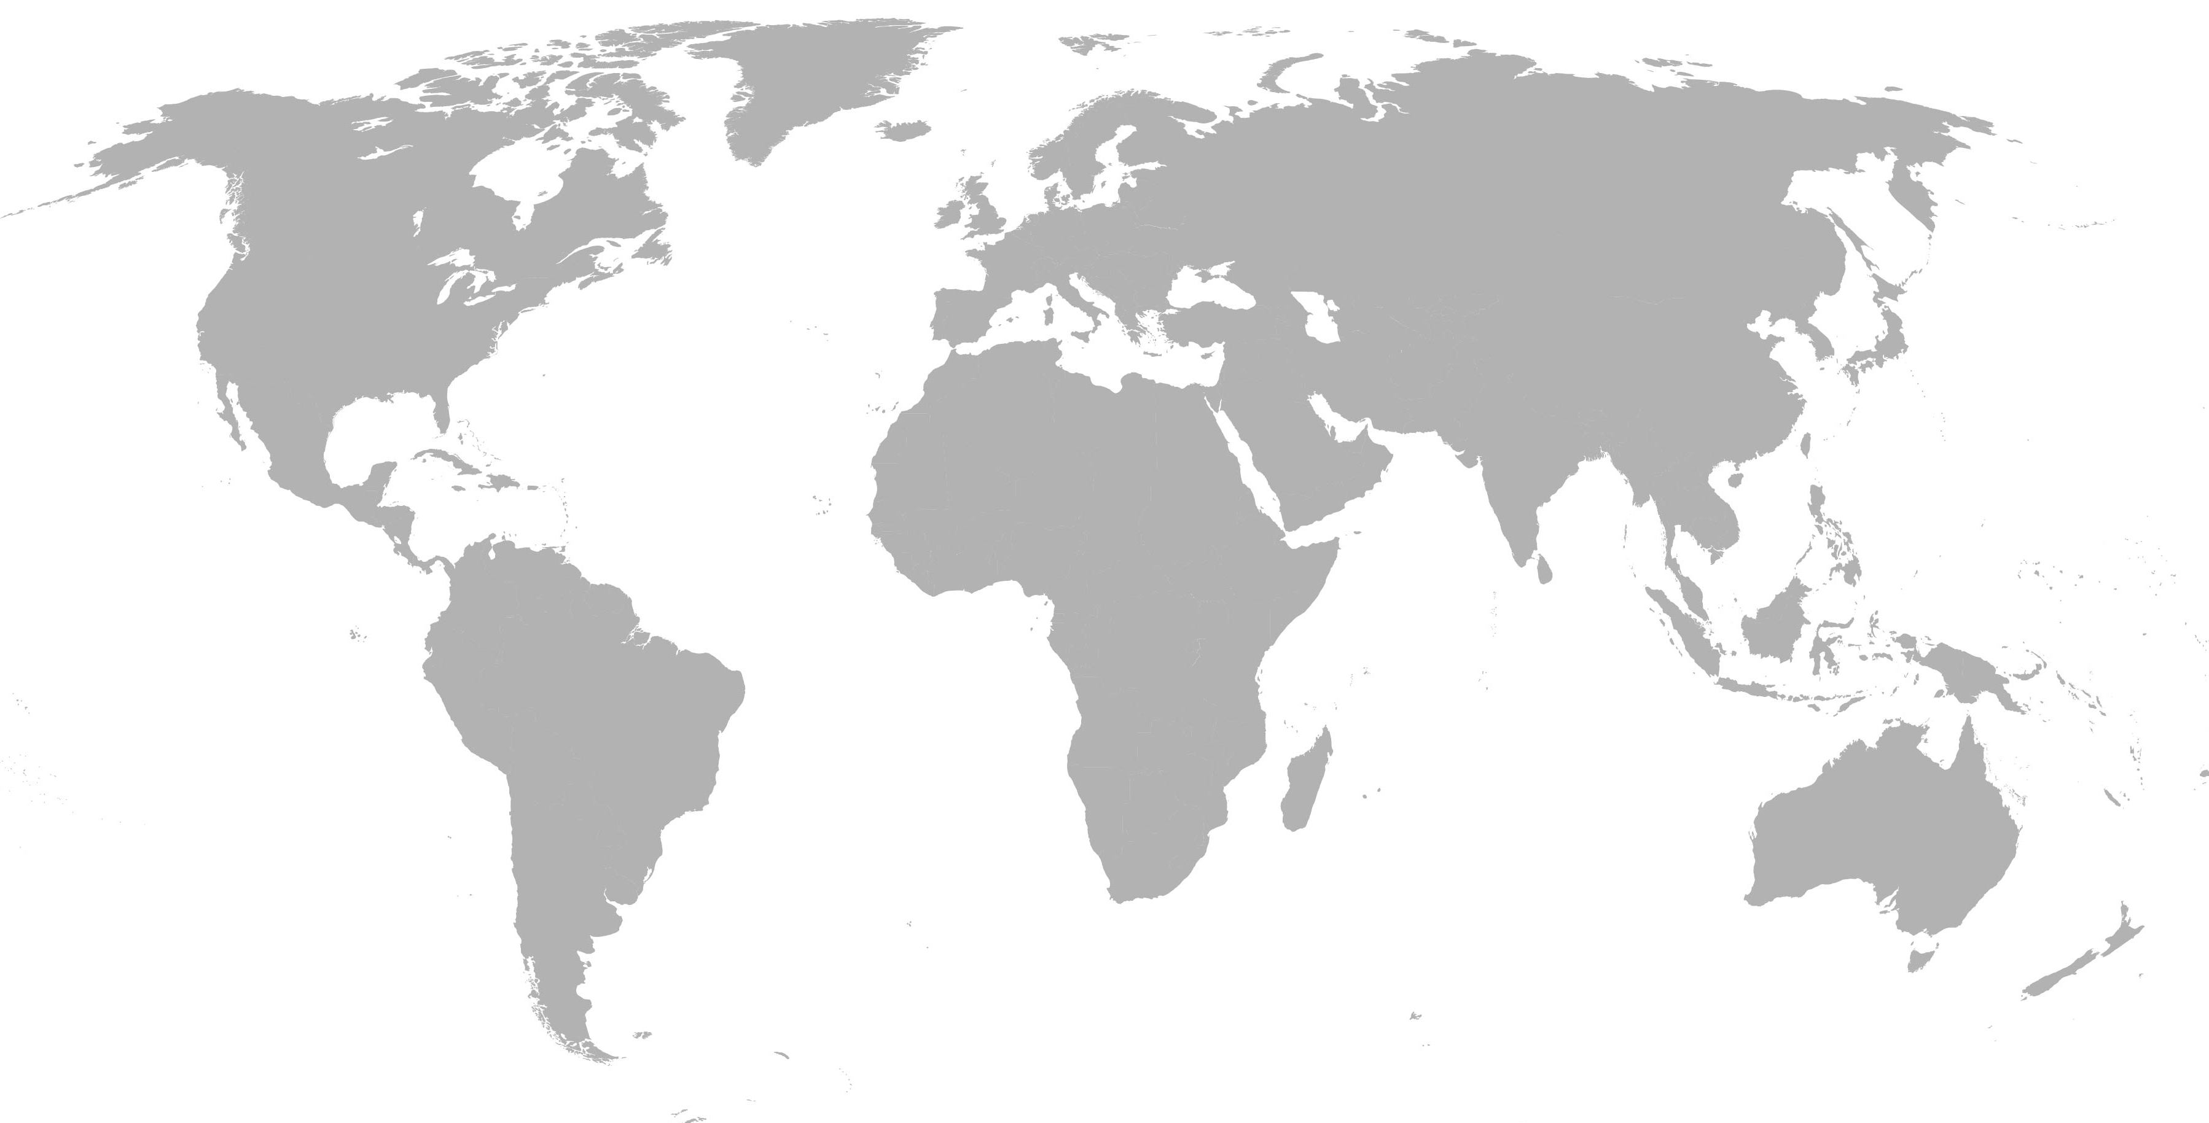
People distribution by main countries
€/MIL
%
people outside Italy: nr. 1582
18.6% in the european subsidiaries

Slide 16
Tax rate comments
€/mln | FY 2015 | 9M 2015 | 9M 2016 | IH 2016
taxes | 17.4 | 11.6 | 14.8 | 9.1
Net Result | 21.1 | 14.9 | 20.9 | 11.9
tax rate 45.3% 43.8% 41.5% 43.2%
projected tax rate
for the plan 34%
Patent Box impact still not totally relevant
conservative approach to the D.T.A. use
the positive effect of the IRAP decrease still not relevant in Italy during the first 9 months

Slide 17
forecast: updating the results waiting for the new 3 years business plan
€/mln | 9M 2015 | FY 2015 | 9M 2016 | FY 2016e | FY 2016e (new)
net sales year -1 | 365.1 | 519.1 + 21.5% | 436.4 +19.5% | 572.1 +10.2% | 595.0 +14.6%
ebitda % | 43.2 11.8% | 64.1 12.4% | 50.8 11.6% | 73.6 12.9% | 70.0 11.8%
ebit % | 29.7 8.1% | 43.8 8.4% | 36.9 8.5% | 51.1 8.9% | 50.0 8.4%
net financial position | -25.8 | +0.1 | -16.7 | +3.5 | +5.0
3 years business plan source

Slide 18
growth driver: main factors
urbanization factor
substitution cycle
digitalization demand - energy efficiency
software integration increase – Industry 4.0 capabilities and incentives
diversification into new segments through innovations

Slide 19
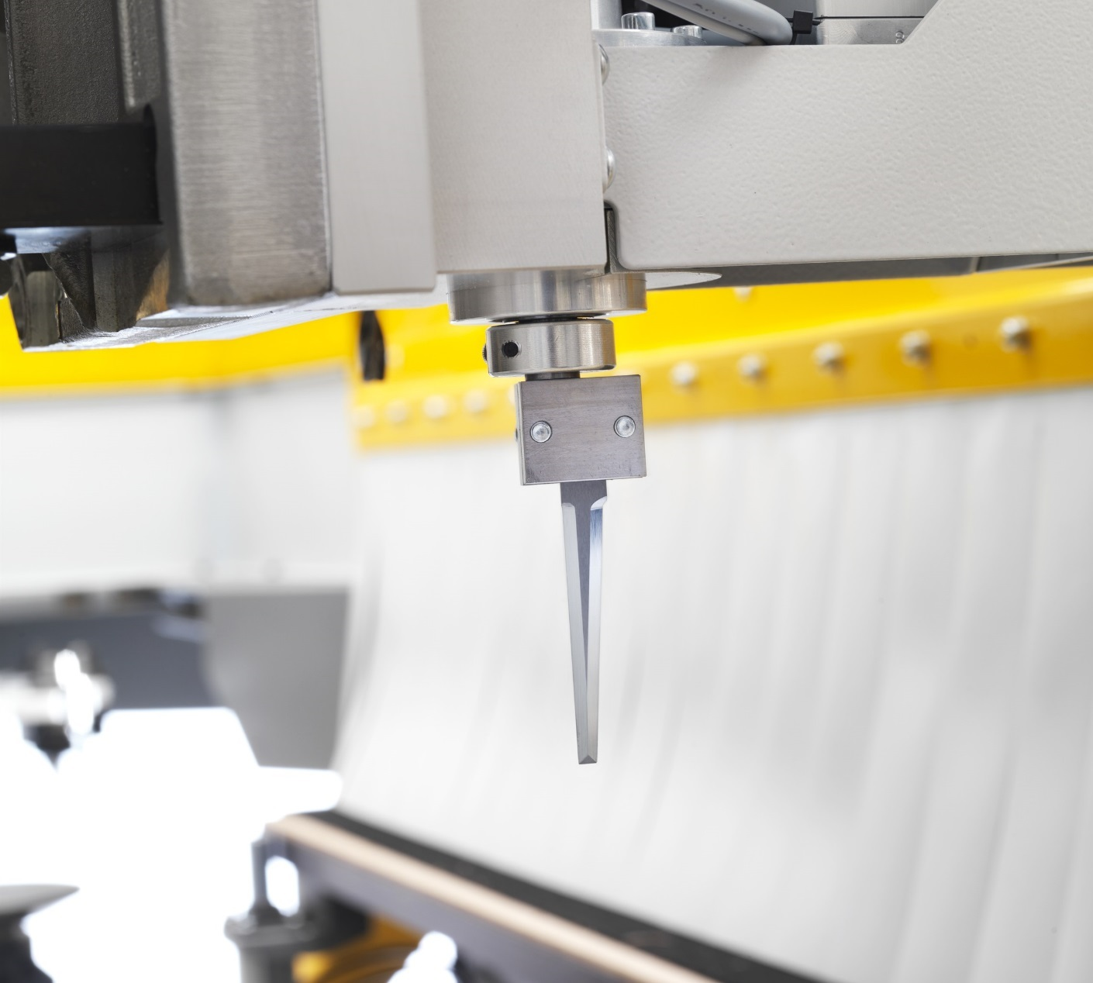
9M update
Advanced Materials*
Adv. Mat.
Targets
9M 2016 update:
approx € 6 mln sales (€ 1.8 mln in 2015)
“already done” 81% of the annual budget
Think4ward
Strategy in actions
*Advanced materials
Carbon Fiber
Foam
Composite
Aluminum
Titanium

Slide 20
Advanced Materials*
Adv. Mat.
3 mln/€
2015 target
3.5 mln/€
2015e result
+16.7%
On target
Business plan remind
Targets
Our successful entry into the plastic & advanced materials sector confirms our capability to diversify into new sectors through our innovative Mechatronics Division and our consolidated expertise.
Think4ward
Strategy in actions
20 mln/€
2018e target
In the future. we will expand our product offering in order to meet the needs of the entire market.
*Advanced materials
Carbon Fiber
Foam
Composite
Aluminum
Titanium

Slide 21
Shareholders breakdown by ownership/ main geographical areas
€/MIL
Bi.Fin s.r.l (Selci family)
free float
Biesse B.o.D:
Giancarlo Selci
Stefano Porcellini
Alessandra Parpajola
Cesare Tinti
Salvatore Giordano (indipendent)
Elisabetta Righini (indipendent)
as per Consob statement no investor officially > 2%
%
Italy is including the Selci family percentage (51%)
Source: Bloomberg

